Slide 1
Odoo Upgrade - Progress Reporting
July 05 to July 09

Slide 2

Overview

Slide 3
Overview
Project Documents and References:
Project Plan link:
https://docs.google.com/spreadsheets/d/18ZDAdHBzsEPdpr6rOwJDw2ViElgeVGW-ovWh-N8FheQ/edit?usp=sharing
Functional Test cases document:
https://docs.google.com/spreadsheets/d/12t1AjhoWo4CEOnC9snuApc7Y9-KMogo06I3qzkV-VHQ/edit?usp=sharing
UAT and Complete QA planning:
https://docs.google.com/spreadsheets/d/1zogqMJEMYcj1Ipb8xfOZKy1jcYYzcgeYiMnl-DUolIM/edit?usp=sharing
General action Items tracking sheet: https://docs.google.com/spreadsheets/d/1CQK9vK6pHrssCAB1glM9QhZQiUsD6ni9HpDKusIilDs/edit?usp=sharing

Slide 4
Progress Report -(July 05 to July 09)

Slide 5
Progress Report Summary - (July 05 to July 09)
Week Highlights:
Modules Migration [By Verts Team]
Saarus:
Competed Saarus ERP Code Migration.
Testing In Demo in-Progress.
Starting the Data - migration process [?]
KNK:
Completed the Migration of KNK Finance and dependent module.
Overall KNK Migration [45% done]
Functional Test cases completion:
Demo of Saarus Manufacturing and Accounting Process is Scheduled on Monday
Next Week Plan and Highlights: [July 12-16)
Modules Migration [By Verts Team]
Complete Migration of KNK Finance Modules and handover and start migrating rest of the KNK modules.
Share Scripts of Data migration for review and plan for release?
Testing:
Verts to Provide the KNK demo on Finance Modules.
Documentation:
Verts Team to share the scope of improvements points found in KNK Finance Migration Migration so far.

Slide 6
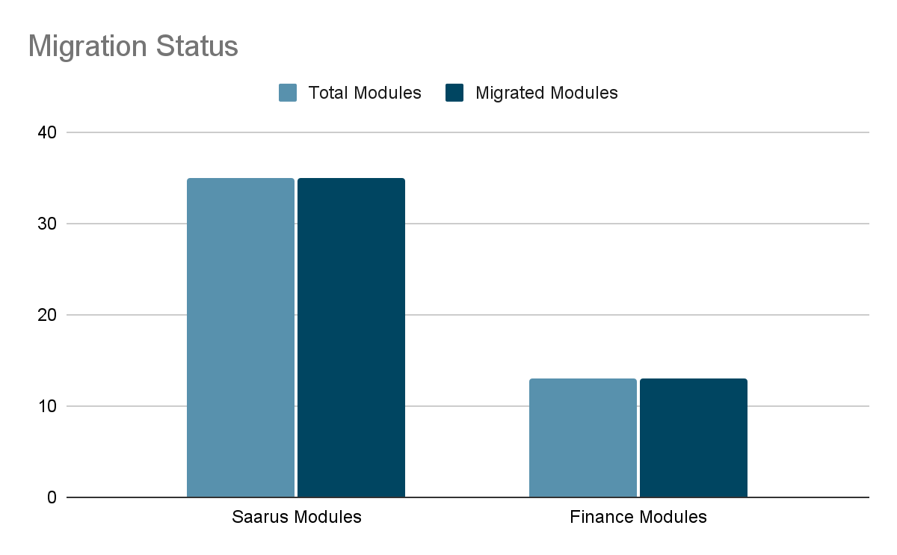
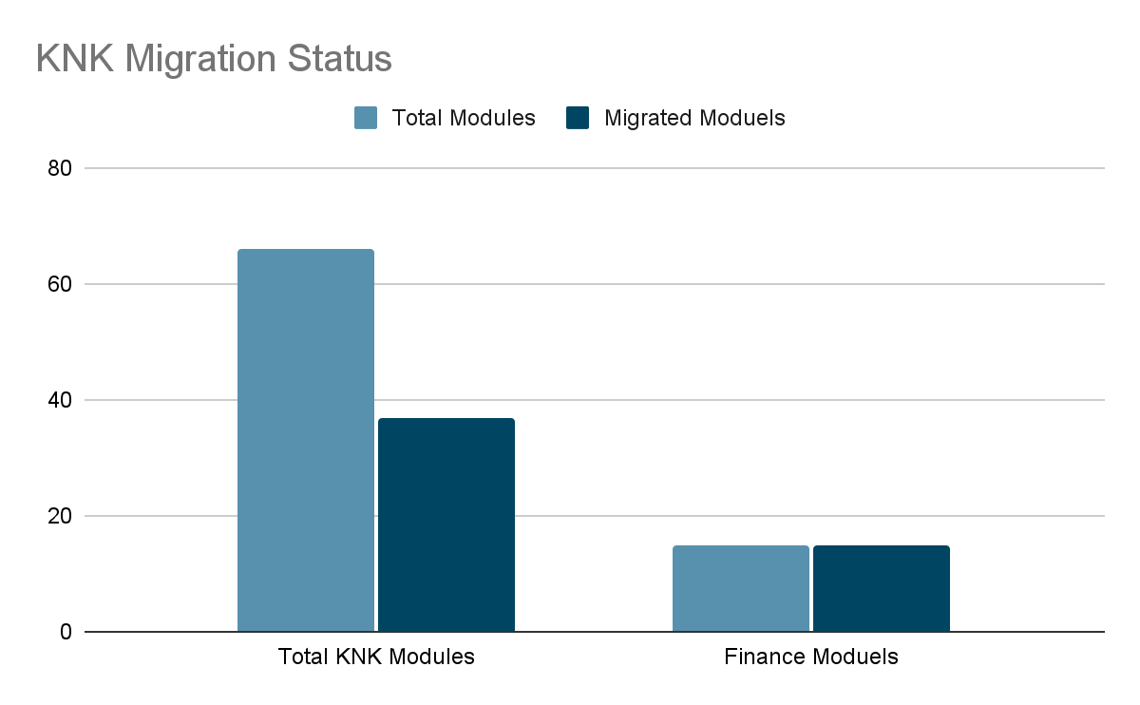
Progress Analysis
Saarus Code Migration Status
KNK Code Migration Status

Slide 7
Risks and Issue
Demo for complete Saarus ERP not yet given, We can not consider the code migration done yet. This is stretching further to the deadline.
KNK Finance Modules demo not yet done, We are running behind the schedule on this.
KNK Server we have a couple of modules, so not sure where we are on this.

Slide 8
Madhav Agarwal
m.agarwal@kokonetworks.com

